Slide 1
PROMOTING THE IMPLEMENTATION OF COMPREHENSIVE SEX EDUCATION.
TEAM VITALIT
Fanoga, Lenard
Garcia, Carlo
Malijan, Justine Miles
Mancilla, Neal Andrus
Rosales, Neil Denver

Slide 2
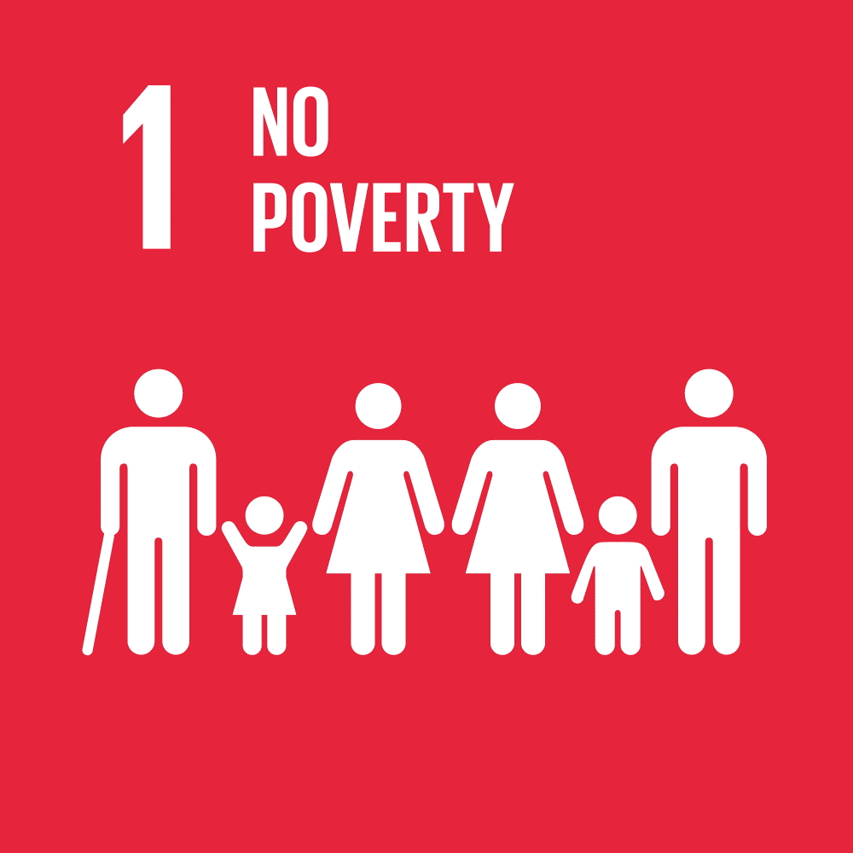
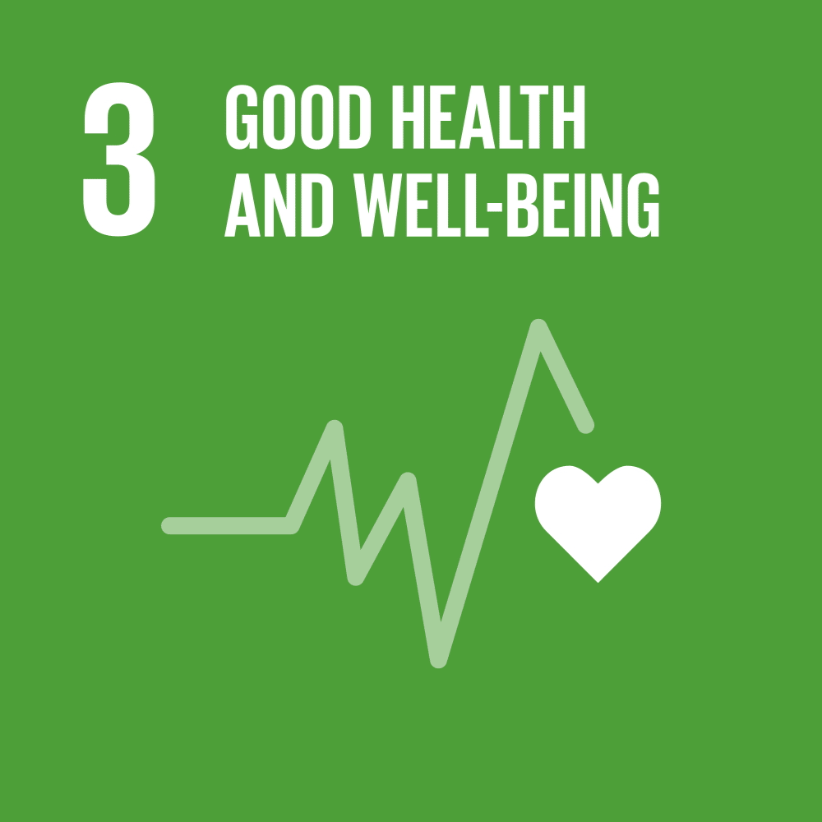
OBJECTIVES

Slide 3
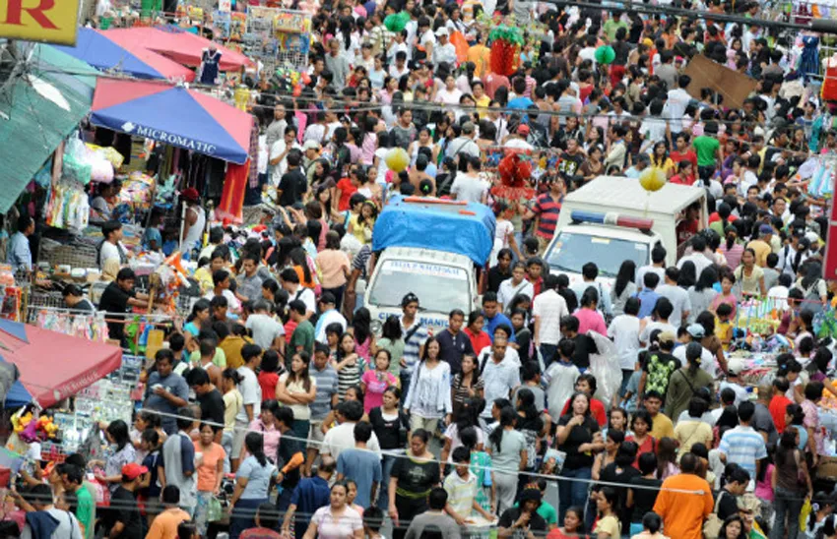
THE PROBLEM
Among Asian countries, the Philippines has one of the highest population densities and fastest growth of population. But since we lack the government funded family planning methods, it holds us back from progressing to a future that we could obtain
PHOTO CREDITS: Arno Maierbrugger for investvine.com

Slide 4
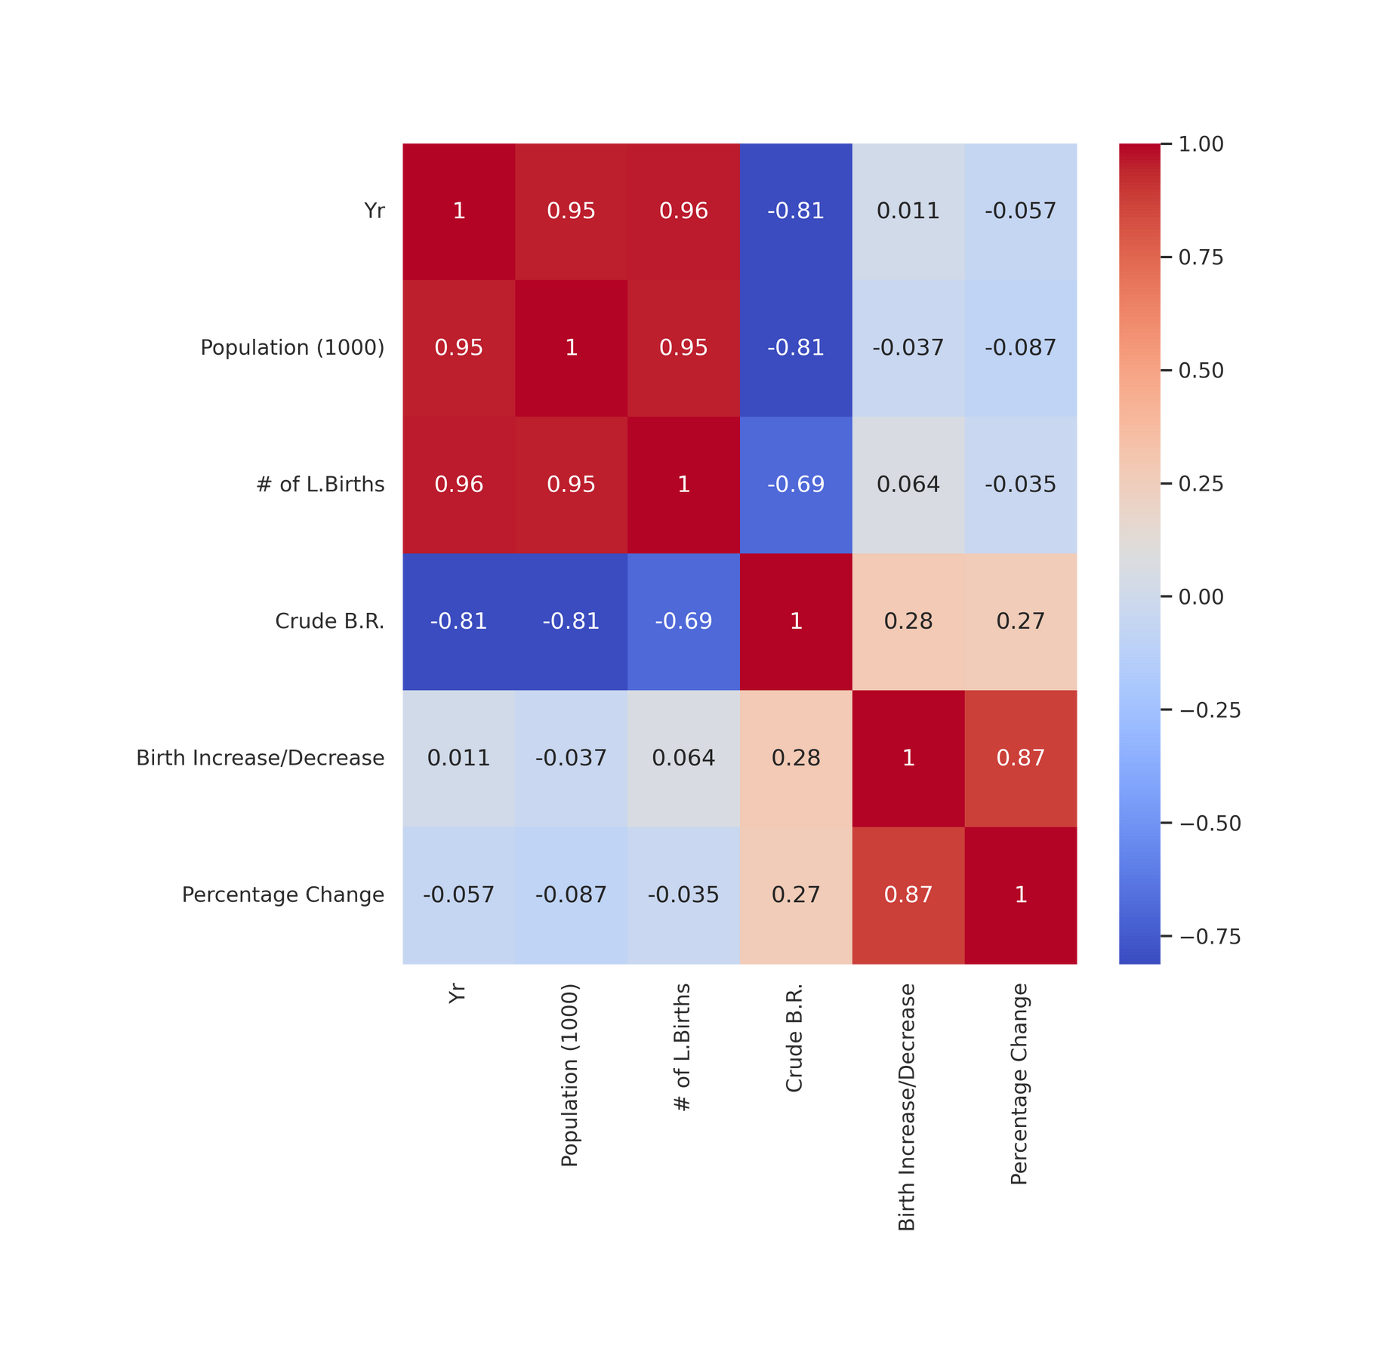

SUMMARY OF BIRTHS STATISTICS IN THE PHILIPPINES:
CORRELATION MATRIX
Strong correlations:
Year and Population
Year and Number of Live Births
DATA SOURCE: Vital Statistics Report 2018

Slide 5
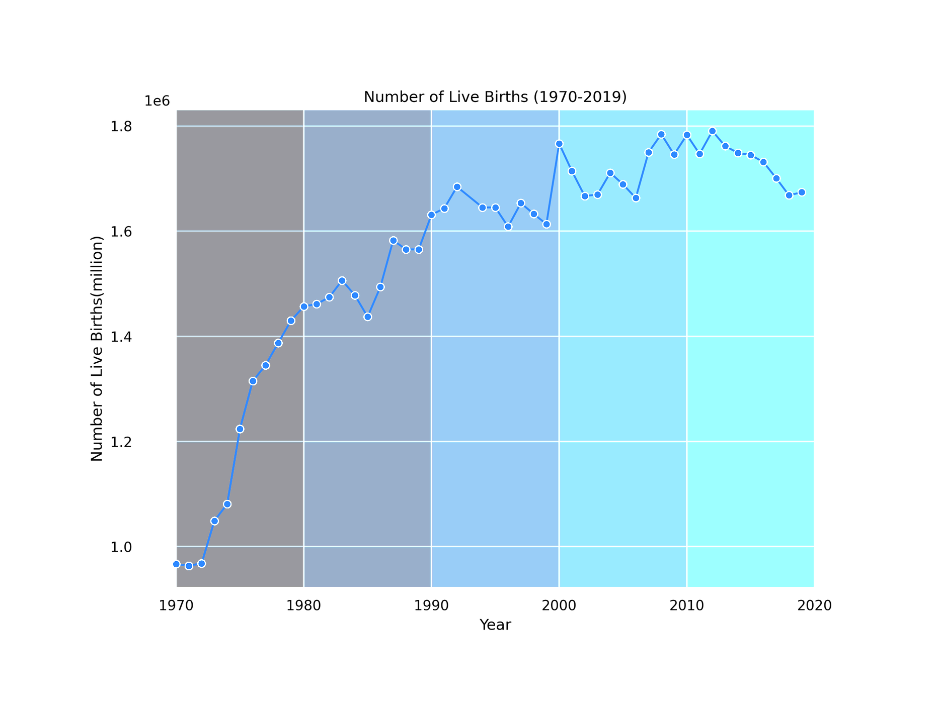
NUMBER OF LIVE BIRTHS (1970-2019)
In 42 years, there has been an 85.19% increase in number of live births from 1970 with 966,762 live births to 2012 peaking with a total of 1,790,367 live births.
DATA SOURCE: Vital Statistics Report 2018

Slide 6
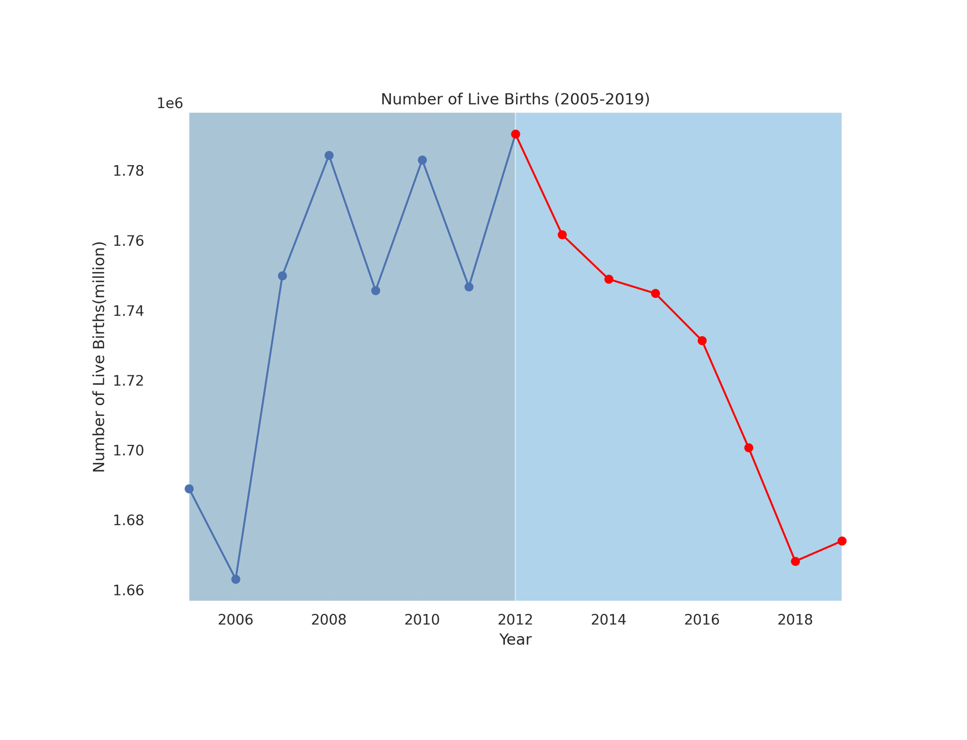
NUMBER OF LIVE BIRTHS (2005-2019)
Due to the Reproductive Health Law 2012, there has been a 6.50% decrease from 2012 with 1,790,367 live births to 2019 with 1,673,923 live births.
DATA SOURCE: Vital Statistics Report 2018

Slide 7
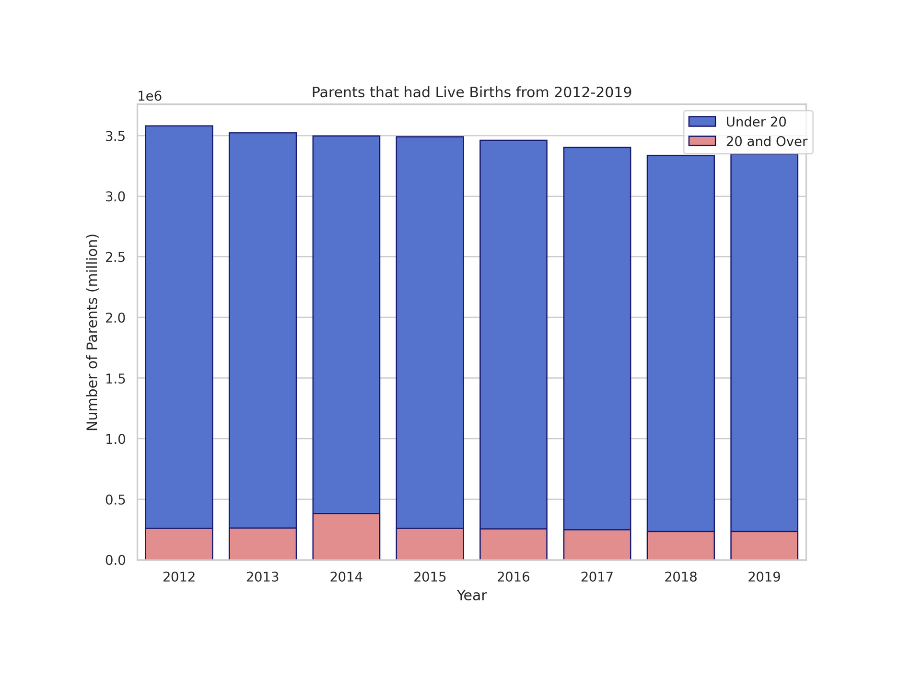
PARENTS THAT HAD LIVE BIRTHS FROM 2012-2019
10.21% decrease from 2012 with 260,216 teenage parents to 2019 with 233,650.
DATA SOURCE: Vital Statistics Report 2012-2019

Slide 8
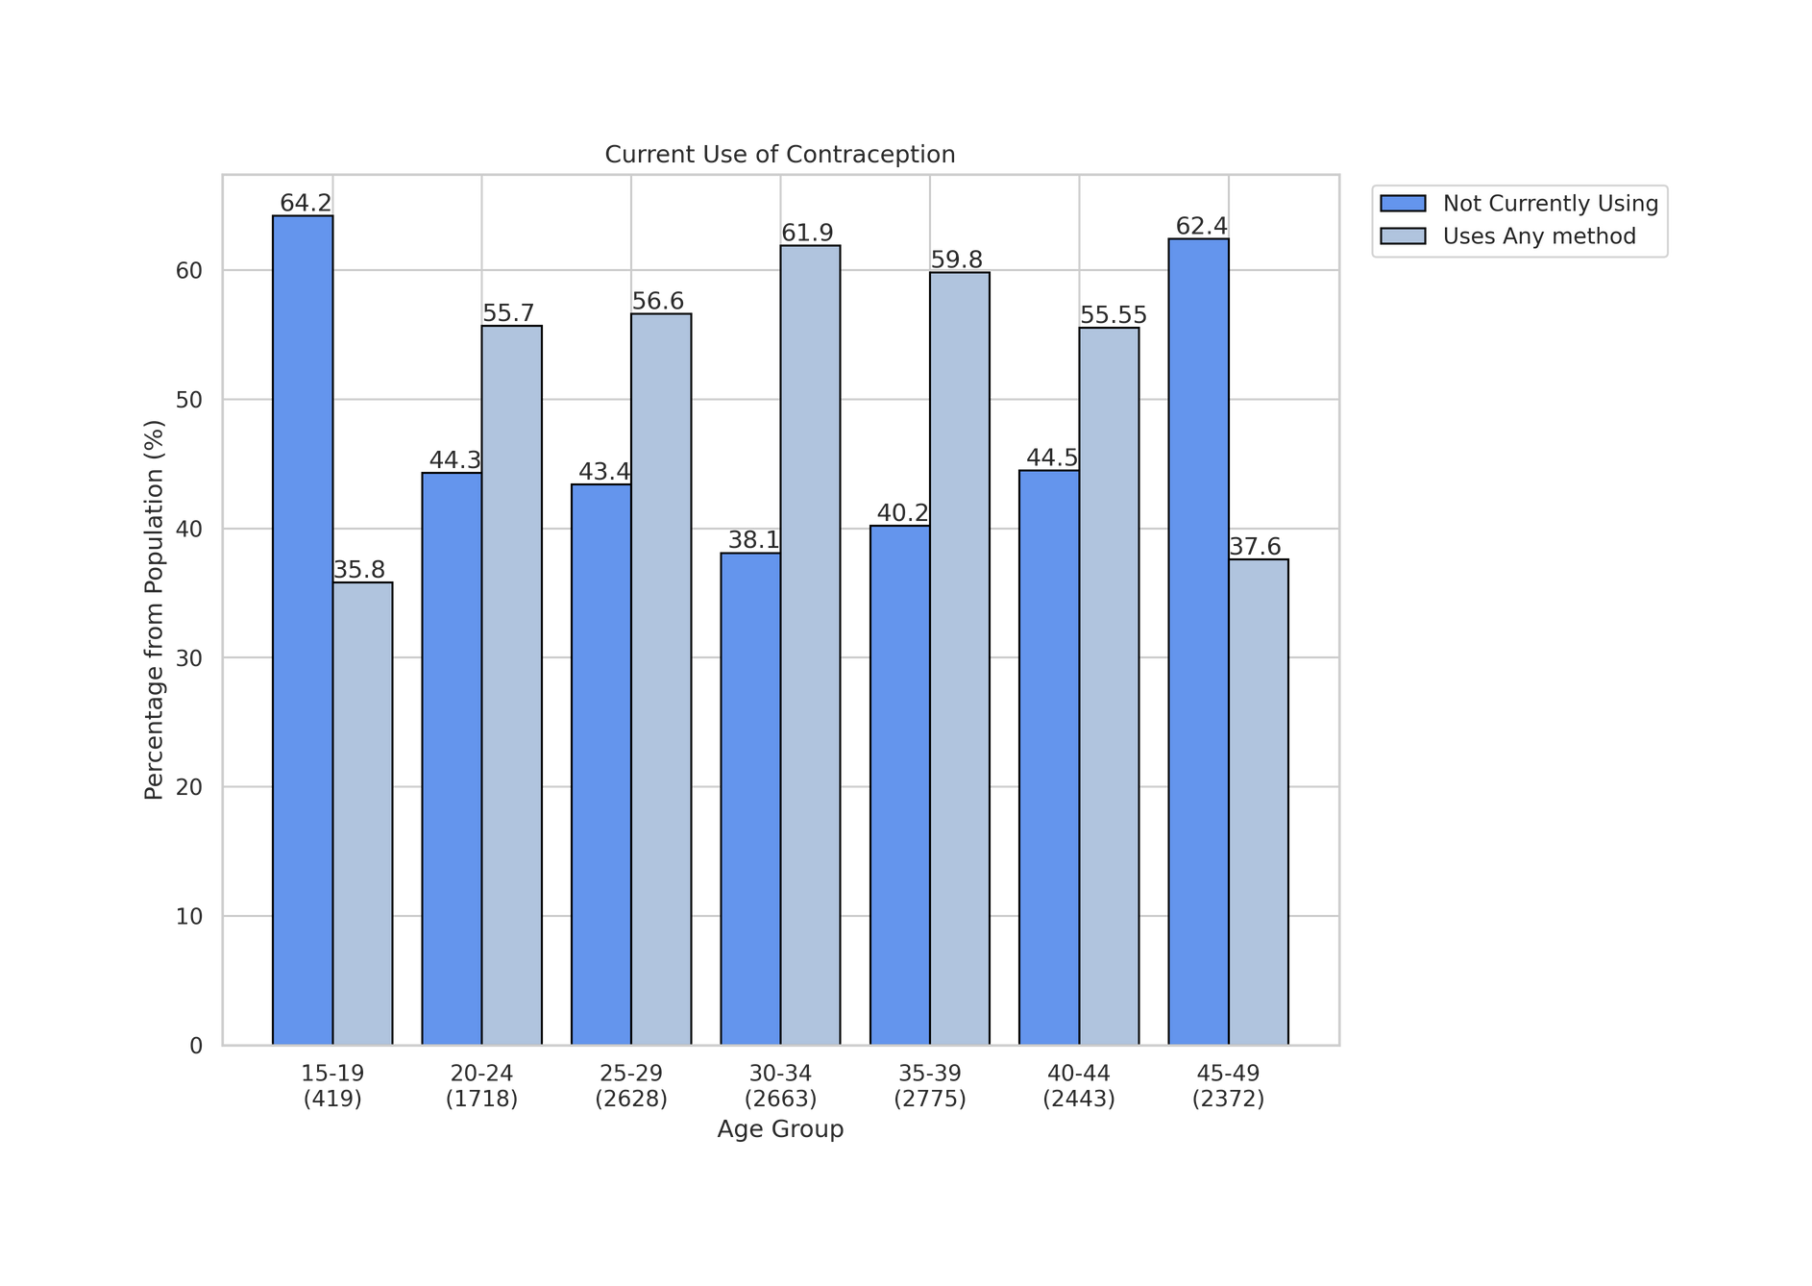
CURRENT USE OF CONTRACEPTION
Surveyed Population:
Currently married and sexually active unmarried women age 15 to 49.
DATA SOURCE: National Demographics and Health Survey 2017

Slide 9
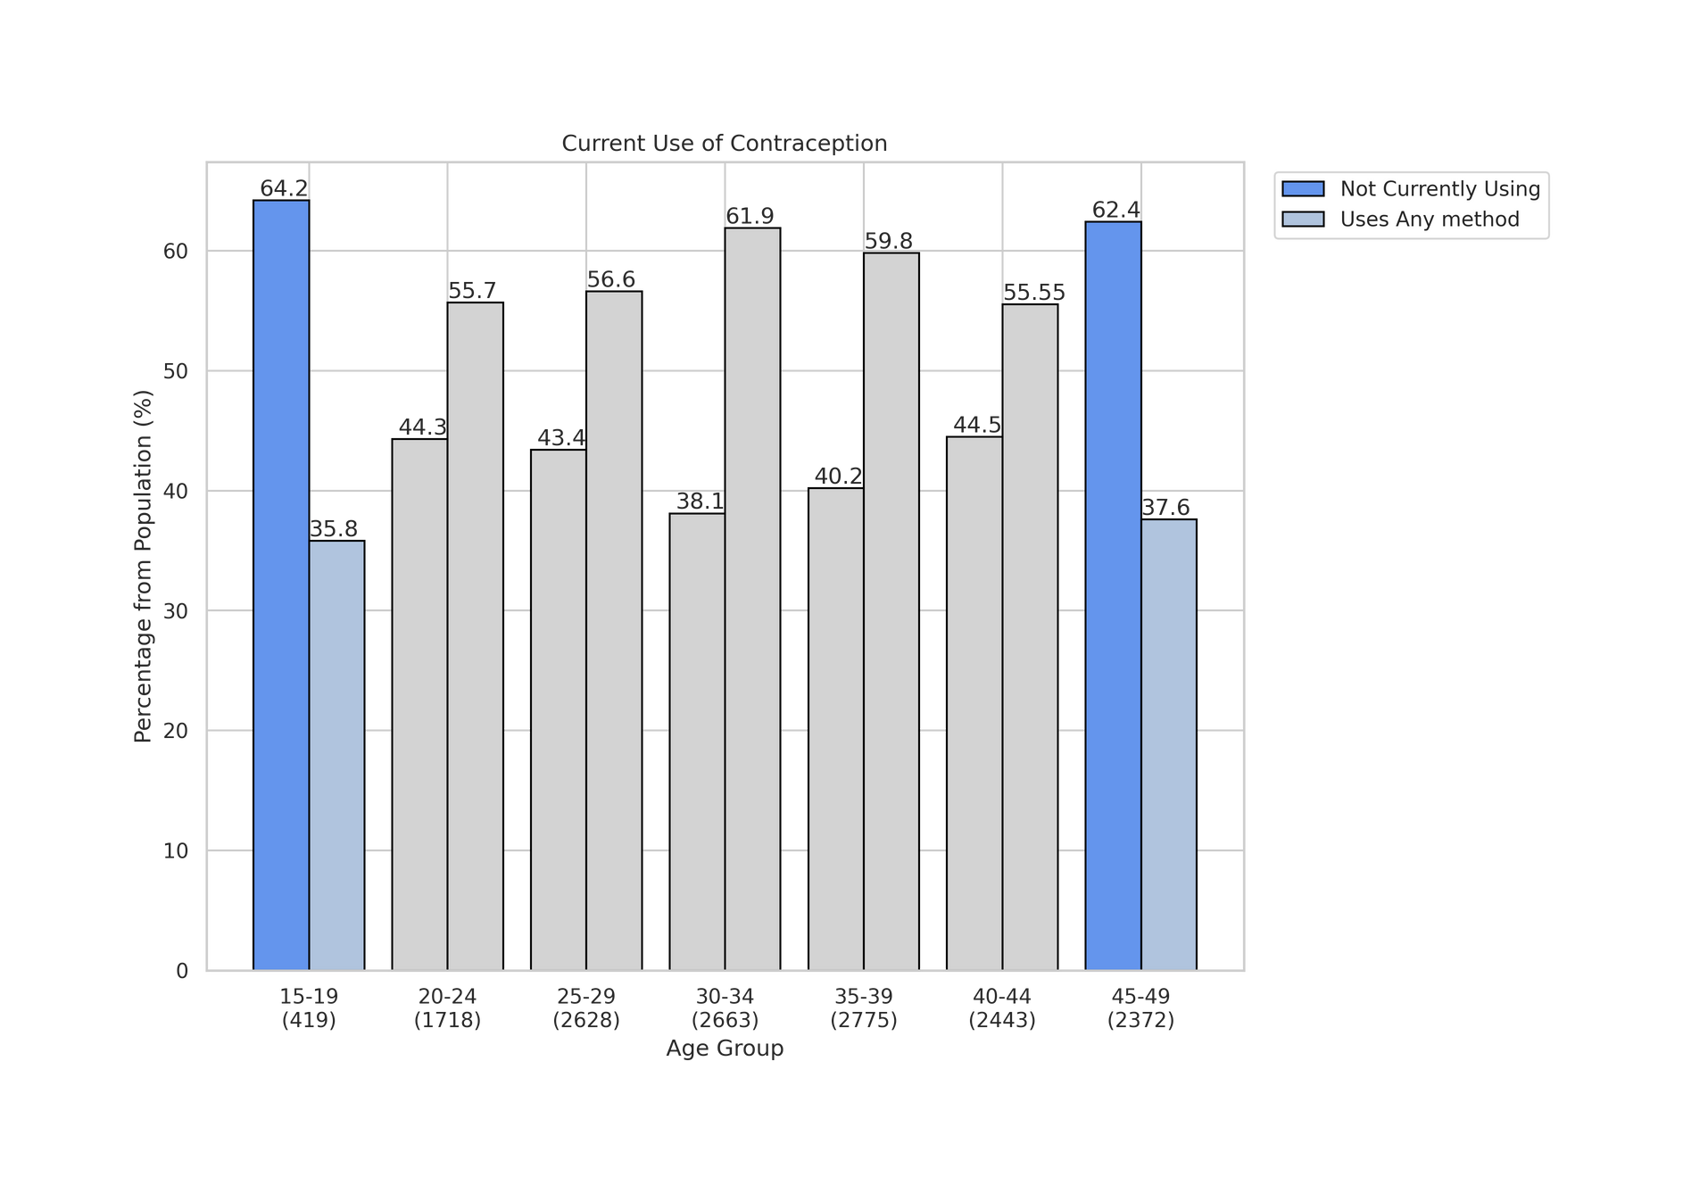
CURRENT USE OF CONTRACEPTION
Top age group with the highest percent distribution of not using any contraceptives is the 15 to 19 age group with 64.2% of them not using contraceptives or 267 of the 419 population.
DATA SOURCE: National Demographics and Health Survey 2017

Slide 10
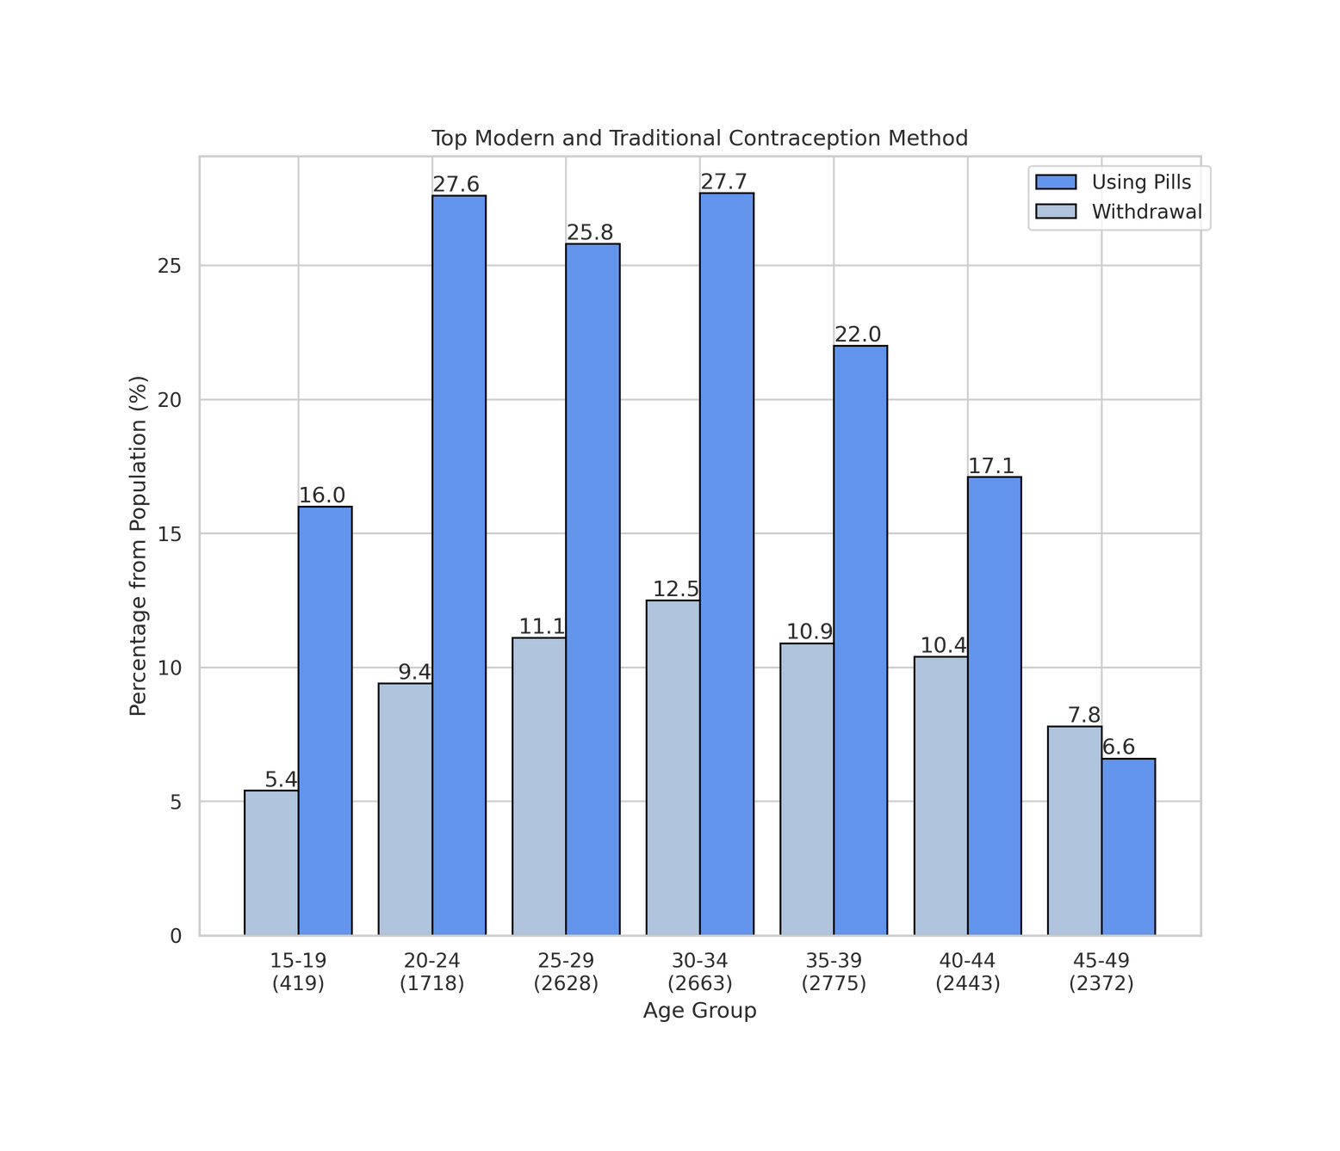


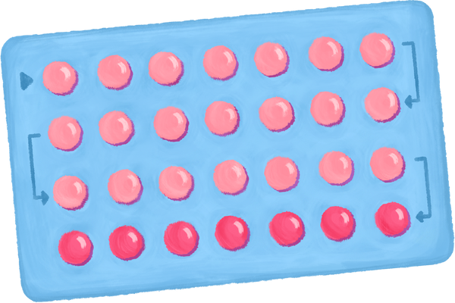
TOP MODERN AND TRADITIONAL CONTRACEPTION METHOD
DATA SOURCE: National Demographics and Health Survey 2017

Slide 11
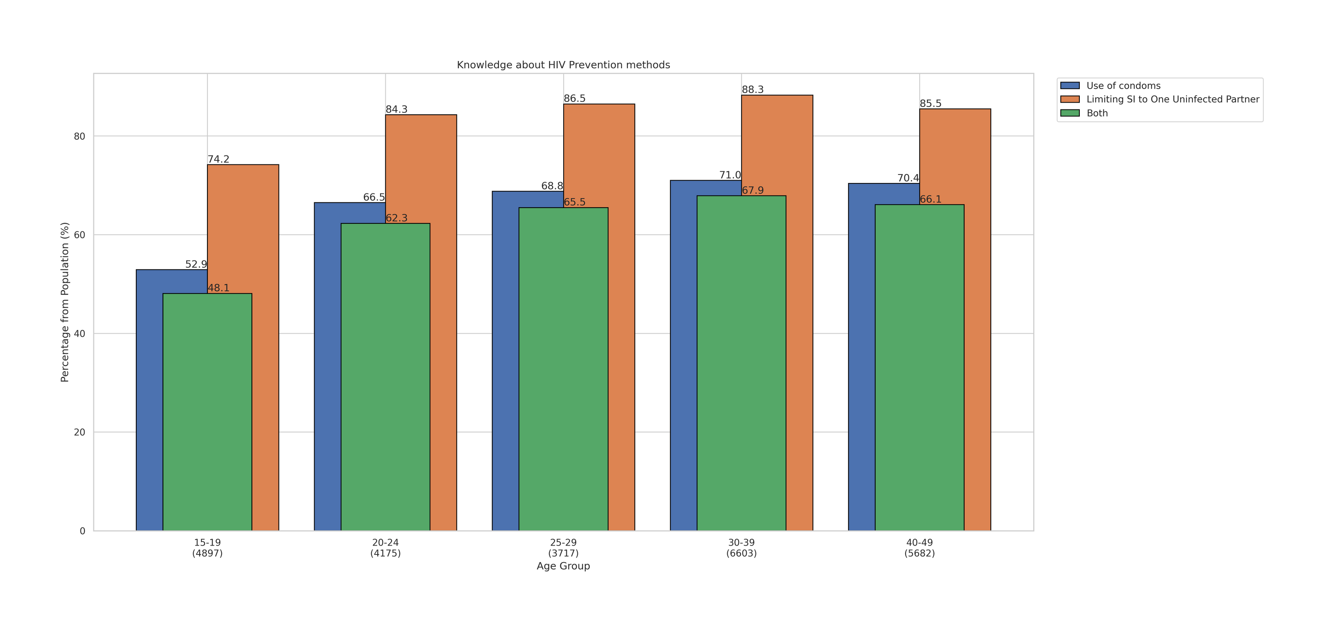
KNOWLEDGE ABOUT HIV PREVENTION METHODS
From the total surveyed population of 25,074, there were only 62% or 15,546 of them who were considered to have comprehensive knowledge about the two HIV prevention methods.
DATA SOURCE: National Demographics and Health Survey 2017

Slide 12

RECOMMENDATION #1
Our first recommendation includes the implementation of a more comprehensive sex education (CSE) to the curriculum of both public and private school since the effectiveness of the first sex education might have been unsatisfactory due to it being only implemented in public schools.
Topics to be included:
Human development
Relationships
Personal skills
Sexual behavior
Sexual health
Society and culture
PHOTO CREDITS: supportingeducation.org

Slide 13
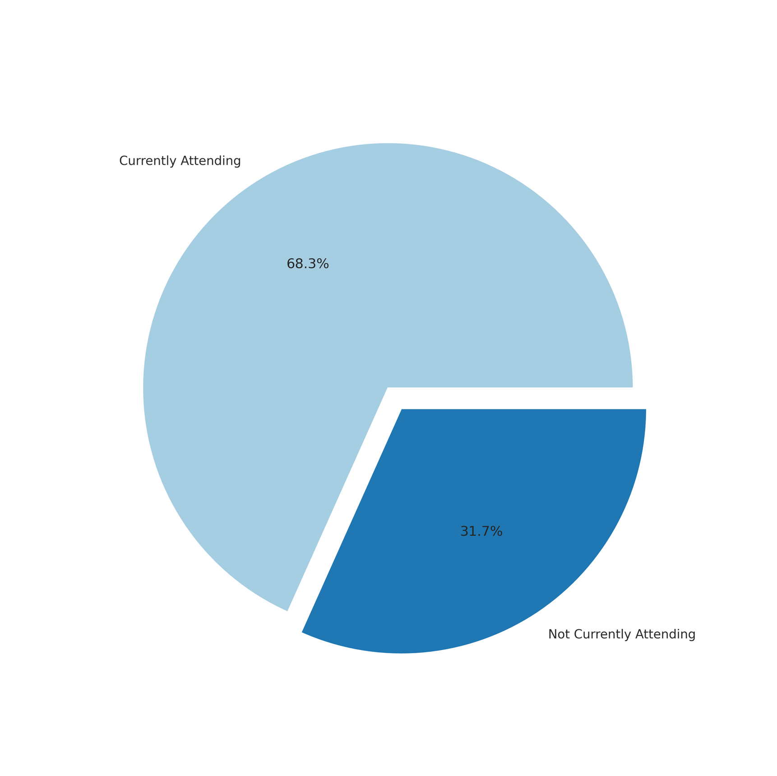
SCHOOLING STATUS
At least 31.7% of the 46 million surveyed population aged 3 to 24 years were not attending their school.
This equates to 14 million Filipinos that would not be able to benefit from the CSE.
DATA SOURCE: Annual Poverty Indicators Survey 2020

Slide 14
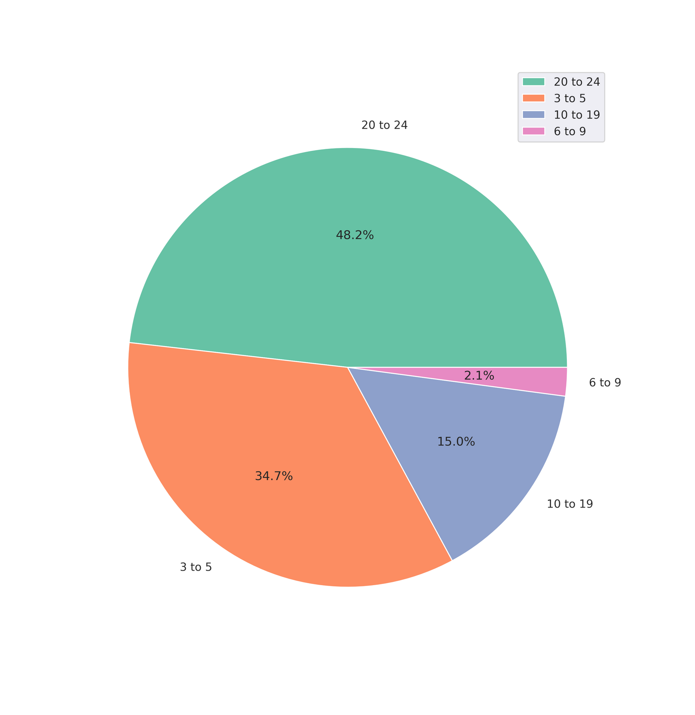
AGE DISTRIBUTION OF SURVEYED POPULATION
From the 31.7% of the population who were not attending school, only 15% are actually eligible for the CSE which is about 2,222,772 teenagers
DATA SOURCE: Annual Poverty Indicators Survey 2020

Slide 15
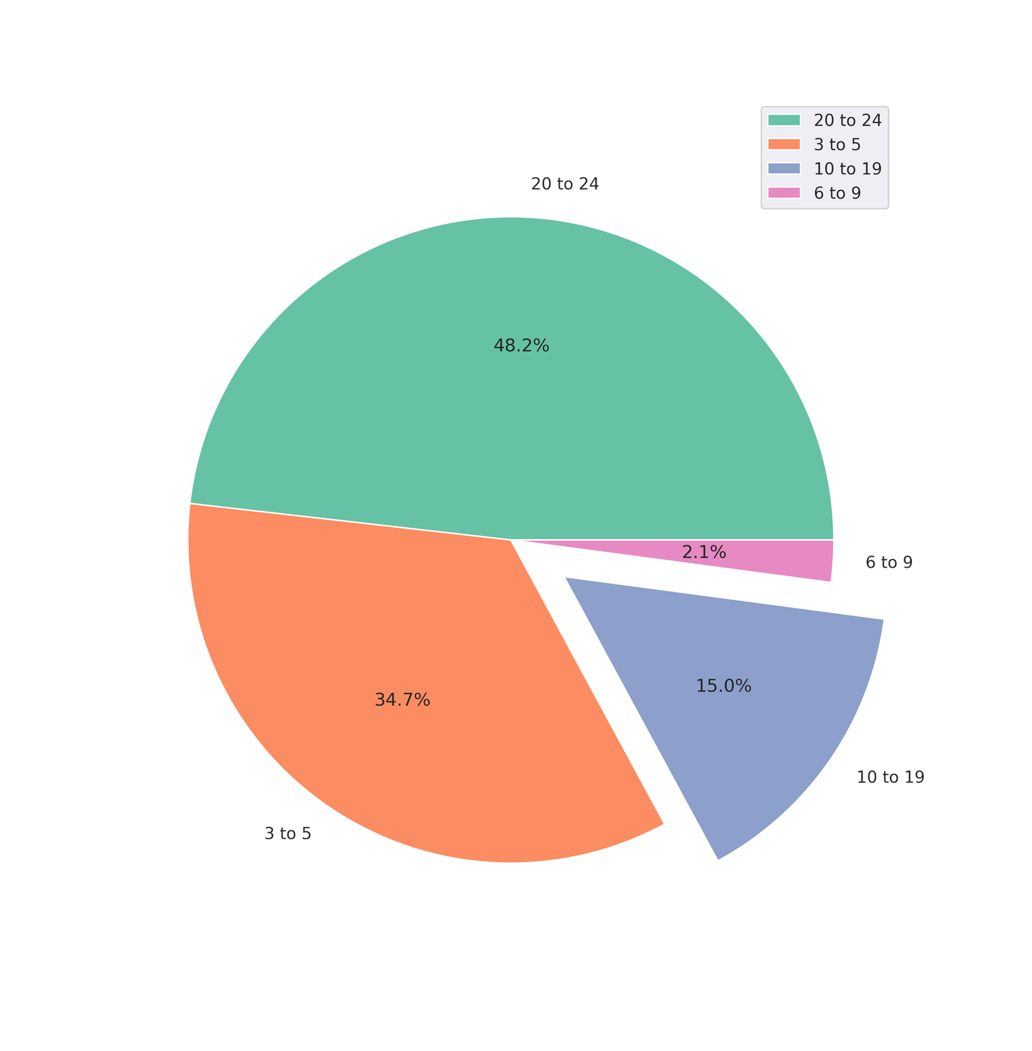
AGE DISTRIBUTION OF SURVEYED POPULATION
From the 31.7% of the population who were not attending school, only 15% are actually eligible for the CSE which is about 2,222,772 teenagers
DATA SOURCE: Annual Poverty Indicators Survey 2020

Slide 16
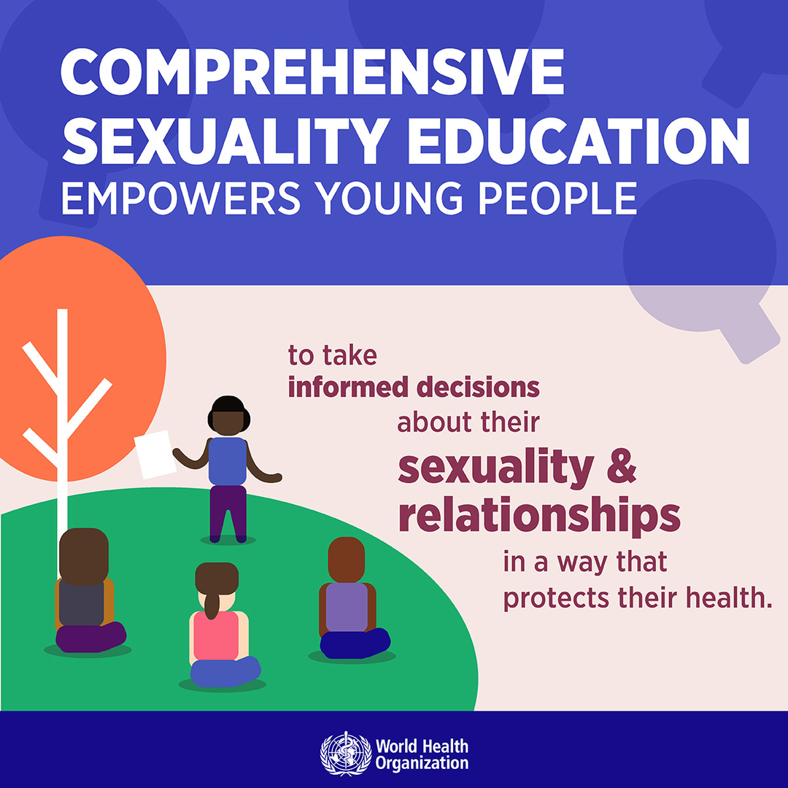
RECOMMENDATION #2
So for our second recommendation, it would include the distribution of CSE pamphlets to every family in a barangay. This recommendation will also need further consultations from medical professionals for it to be comprehensive and easy to understand. But for now, it will include basic information about sex, sexuality, relationships, contraceptive methods that are available at health clinics and their locations per municipality, different types of STD’s and so forth.
PHOTO CREDITS: World Health Organization

Slide 17
THANK YOU!

